Slide 1

Monitoring and Evaluation (M&E) Mechanism

Slide 2
Monitoring and Evaluation
Monitoring explains the efficiency and effectiveness of operations while evaluation provides information on the benefits achieved
Monitoring results provide bases for critical management decisions such as resource allocation or realignment, target setting, remedial/corrective actions or strategy development.
Evaluation results provide valuable lessons and insights that can be used by managers in crafting strategic decisions for the future such as in designing organizational changes or future programs and/or projects.
DEPARTMENT OF EDUCATION

Slide 3
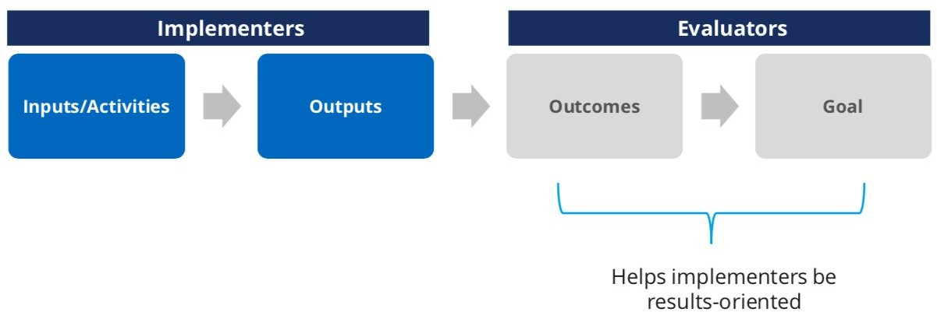
Theory of Change (ToC)
Source: Innovations for Poverty Action Theory of Change lecture slides
DEPARTMENT OF EDUCATION

Slide 4
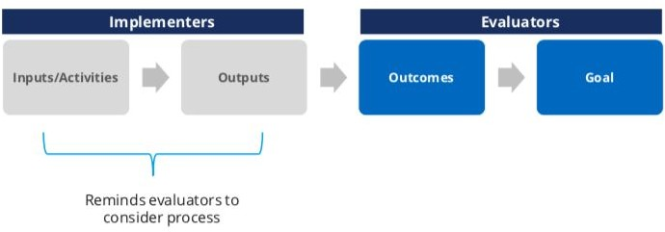
Theory of Change (ToC)
Source: Innovations for Poverty Action Theory of Change lecture slides
DEPARTMENT OF EDUCATION

Slide 5

Types of M&E
Monitoring
Results Evaluation
Process Evaluation

Slide 6
Types of M&E
Monitoring
A systematic and objective assessment of an on-going implementation of plans, programs, projects, and major activities.
Aims to steer implementation as efficiently as possible based on empirical facts determined through verifiable assessment process, systematic observation and documentation.
Also determines any adjustment of plans and activities needed to achieve the committed targets.
Monitoring may be done on a weekly, monthly, or quarterly basis depending on the M&E Plan.

Slide 7
Types of M&E
DepEd Monitoring
The Program Management Information System (PMIS) is one of the mechanisms in doing monitoring and currently the official source of data on programs, projects and activities (PPAs) from planning to implementation.
In support of monitoring and evaluation, Program Implementation Review (PIR) is established as the reporting platform. The PIR is conducted on a quarterly basis to report the accomplishments of outputs in terms of efficiency, and corresponding utilization of the budget.

Slide 8
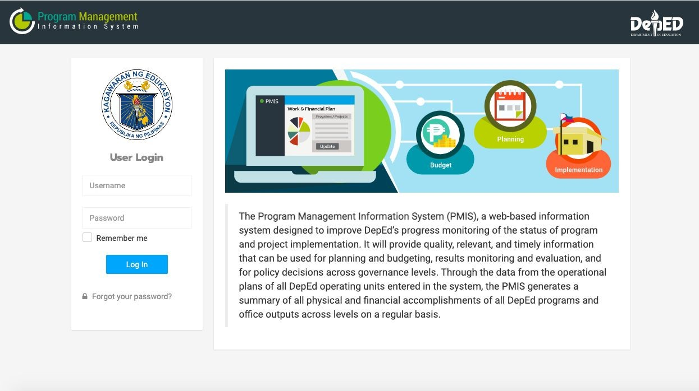

Slide 9
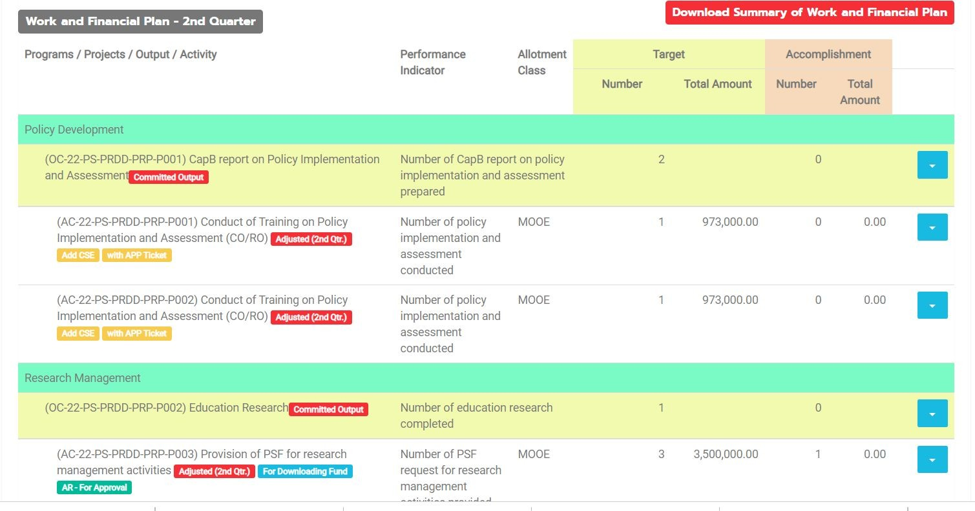

Slide 10
Types of M&E
Results Evaluation
This is an evaluation approach that focuses on
measuring the realization of results.
It seeks to assess the outcomes and changes
brought about by program or project interventions.
Findings from this type of evaluation are used as the
baseline situation for the next planning cycle.

Slide 11

DEPARTMENT OF EDUCATION
102

Slide 12
Types of M&E
Process Evaluation
Determines the effectiveness and efficiency of the implementation processes and systems.
This could be conducted at any phase of the plan implementation and could be combined with other types of monitoring.
Through this evaluation, issues and challenges in program, project, and activity deliveries can be addressed.

Slide 13
Types of M&E
Process Evaluation
Sample questions to ask…
What were specific interventions put into place by the program to fight the problem being tackled? Did the interventions work or not — and how and why?
What were the kinds of problems encountered in delivering the program — were there enough resources from the beginning to do it well? Was it well managed? Were staff trained or educated to the right level of the program design? Is there skill at facilitating the program processes from beginning to end? Was there adequate support to the program?

Slide 14

Example
14

Slide 15

15

Slide 16
Check for understanding
SGOD of SDOIN aims to determine the extent of implementation of limited F2F class to identify best practices, issues and areas for improvement. What types of M&E will they use?
Monitoring of outputs
Process Evaluation
Results Evaluation
All of the above
16

Slide 17
Operationalizing the Conduct of M&E
17

Slide 18

110

Slide 19
How do you prepare for the conduct of M&E?
DEPARTMENT OF EDUCATION
111

Slide 20
Operationalizing the M&E
In operationalizing the conduct of M&E, all operating units are required to develop M&E Plans for their respective education plans, programs, and policies.
The M&E Plan is a document that provides guidance on the purpose and process of conducting monitoring and evaluation of any programs, policies, projects, office mandates, and activities.
The M&E plan contains four (4) core M&E processes.
DEPARTMENT OF EDUCATION

Slide 21





M&E CORE PROCESSES
I. Establishment of Purpose and
Scope
II. Data Collection and Management
III. Data Analysis
IV. Information Dissemination, Reporting, and
Utilization

Slide 22


M&E CORE PROCESSES
I. Establishment of Purpose and Scope
Guide Questions
What should you be monitoring and evaluating?
What are the corresponding indicators?
Reference point for the M&E system, guiding key decisions such as informational needs, methodological approaches, capacity building and allocation of resources.

Slide 23
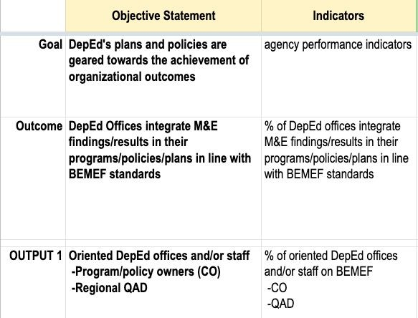
M&E CORE PROCESSES
Sample: Core Process 1 of BEMEF

Slide 24

M&E CORE PROCESSES
Guide Questions
What are the possible sources of data?
Who (office/personnel) is responsible in data collection?
How frequent will you collect this data?
How will you organize and store the collected data?
Who are the possible users of the data (internal and external) and what are the possible uses of these data?
II. Data Collection and Management
Collection or gathering of relevant data to be managed for analysis. It involves processes and systems for how a project/program will systematically and reliably store, manage and access M&E data.

Slide 25
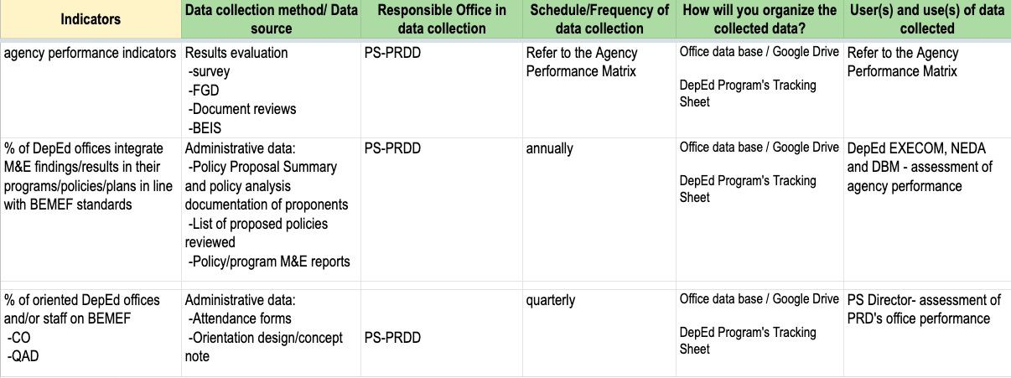
M&E CORE PROCESSES
Sample: Core Process 2 of BEMEF

Slide 26

M&E CORE PROCESSES
III. Data Analysis
Guide Questions
How will you process and analyze the data that you have collected?
Who are responsible in data analysis?
How often do you conduct data analysis?
Process of converting collected (raw) data into usable information. It Involves looking for trends, clusters or other relationships between different types of data, assessing performance against plans and targets, forming conclusions, anticipating problems and identifying solutions and best practices.

Slide 27
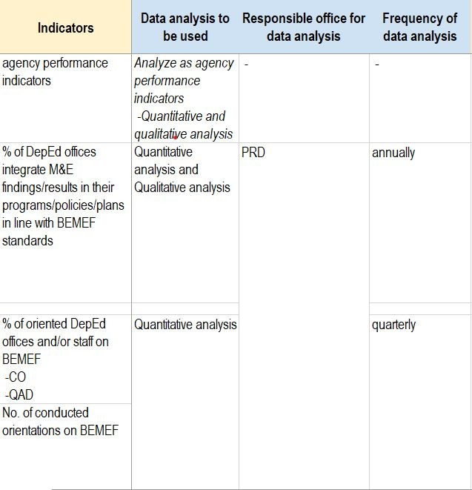
M&E CORE PROCESSES
Sample: Core Process 3 of BEMEF

Slide 28

M&E CORE PROCESSES
IV. Information Dissemination, Reporting, and
Utilization
Guide Questions
To whom will you communicate the M&E results? (identifying type of stakeholder/audience
How will you communicate the results? What are communication / reporting strategies will you employ?
When do you report M&E results?
The most visible part of the M&E system.
Collected and analyzed data is presented as information for use of key stakeholders.

Slide 29
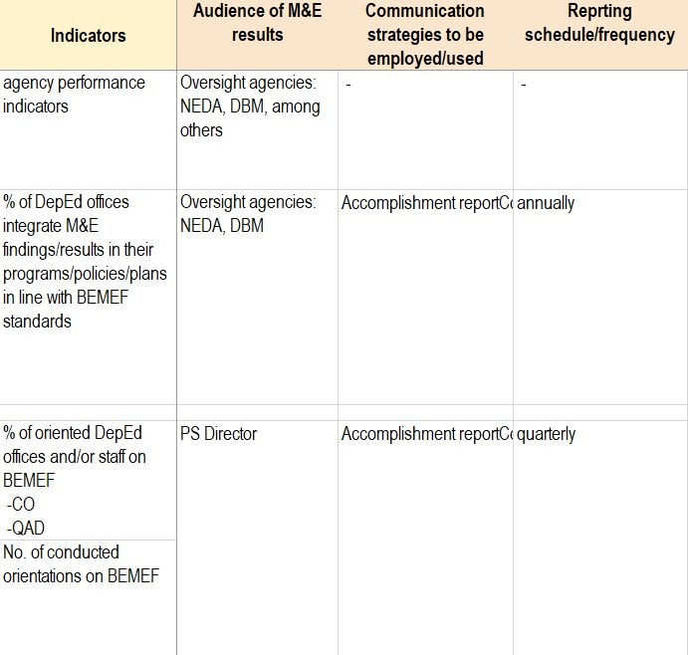
M&E CORE PROCESSES
Sample: Core Process 4 of BEMEF

Slide 30
M&E Core Processes
The development of tools for data collection/requirements shall be guided by the M&E Plan to be established per program, policy, and plan.
DEPARTMENT OF EDUCATION

Slide 31
M&E SYSTEM PER GOVERNANCE LEVEL
31

Slide 32
M&E SYSTEM PER GOVERNANCE LEVEL
The M&E system shall serve as an integrating mechanism across governance levels and within operating units of the Department.
This shall provide the DepEd’s decision-makers with evidence-based information on the applicability and feasibility of formulation and implementation of policies, programs, projects, and major activities in the Department.
32

Slide 33
M&E SYSTEM PER GOVERNANCE LEVEL
The vertical integration of the M&E system across governance levels is the systematic alignment of development and implementation of basic education plans, policies, programs, projects, major activities, and M&E processes from national to region, region to school division, and school division to school level and vice versa.
National (Central Office)
Regional Office
Schools Division Office
School Level
33

Slide 34
M&E SYSTEM PER GOVERNANCE LEVEL
The horizontal integration of the M&E system within governance levels shall align the development and implementation processes of basic education plans, policies, programs, projects, major activities, and M&E processes among operating units in a particular governance level.
National (Central Office)/ Regional/SDO/School
Office/ Unit
Office/ Unit
Office/ Unit
Office/ Unit
34

Slide 35
M&E SYSTEM PER GOVERNANCE LEVEL
BEMEF shall enable each office to come up with a more holistic and integrated analysis of their entire governance situation.
To make the M&E system functional, all DepEd operating units across governance levels shall conduct the M&E of their respective basic education plans, policies, programs, projects, and major activities in accordance to BEMEF and corresponding standards.
35

Slide 36
M&E SYSTEM PER GOVERNANCE LEVEL
M&E System
National M&E system | defines the scope of DepEd M&E system includes continuous review and enhancements of performance indicators that shall ensure that needs of all learners are addressed
Regional M&E system | ensures the effective, efficient, and inclusive implementation of all education policies & programs and achievement of desired outcomes provides the policy makers and implementers with timely and appropriate feedback on the implementation of DepEd policies, programs, and delivery systems

Slide 37
M&E SYSTEM PER GOVERNANCE LEVEL
M&E System
School Division M&E system
focuses on determining effectiveness and inclusiveness of schools in providing basic education services
serves as a mechanism for reflection on the SDO’s capacity to provide timely and needs-based basic education support services to schools
School M&E system
makes teaching and learning process more
learner-centered and school-based management more effective and inclusive
provides the platform for shared governance in developing, implementing, and sustaining effective inclusive schools
provides school heads, teachers, non-teaching staff, and communities with critical insights, lessons, and timely information on the performance of all learners

Slide 38
M&E SYSTEM PER GOVERNANCE LEVEL
SDO M&E System shall:
Establish a results-based M&E at the school division level;
Strengthen the link of M&E systems between SDO and schools;
Ensure the integration of M&E initiatives of SDO operating units;
Monitor the effective and efficient implementation of education policies and programs;
Ensure that M&E standards and processes are implemented at the SDO and school levels;
38

Slide 39
M&E SYSTEM PER GOVERNANCE LEVEL
SDO M&E System shall:
Facilitate exchange of information, practices, insights, lessons and issues between and among operating units and external stakeholders;
Provide feedback to RO on the SDO M&E results;
Ensure the integration of M&E results in developing local education plans and programs, and in implementing national education policies and systems both at the SDO and school levels;
Provide M&E technical support and capacity building intervention to schools; and
Link M&E results to the organizational and individual performance.
39

Slide 40
M&E SYSTEM PER GOVERNANCE LEVEL
School M&E System shall:
Ensure the periodic conduct of M&E in all school operations and processes in accordance with existing standards;
Track operational bottlenecks and issues to update, calibrate, and differentiate response every school year and regularly examine and customize teaching strategies;
Formalize interface between and among school head, teachers, and non-teaching staff to discuss operational issues and challenges;
40

Slide 41
M&E SYSTEM PER GOVERNANCE LEVEL
School M&E System shall:
Facilitate participation of learners, communities, and other key stakeholders in the exchange of information, practices, insights, lessons and issues;
Maintain records of M&E results and integrate such in the preparation of SIP, OPCRF, and other school projects and programs;
Report to the SDO the M&E results for appropriate technical support; and
Link M&E results to the organizational and individual performance.
41

Slide 42
Check for understanding
It Involves looking for trends, clusters or other relationships between different types of data, assessing performance against plans and targets, forming conclusions, anticipating problems and identifying solutions and best practices.
Purpose and Scope
Data Collection and Management
Data Analysis
Utilization, Dissemination, and Reporting
42

Slide 43
Roles and Responsibilities of Offices
DEPARTMENT OF EDUCATION
139

Slide 44
ROLES AND RESPONSIBILITIES OF OFFICES
M&E System | Overall Lead | Process Owner | Responsible Offices
National | Secretary | Planning Service | All operating units
Regional | Regional Director | Quality Assurance Division | All operating units
School Division | School Division Superintendent | Schools Governance and Operations Division | All operating units
School | School Head | School Head | All personnel and stakeholders in the school

Slide 45




OVERALL LEAD
SECRETARY
SCHOOLS DIVISION SUPERINTENDENT
SCHOOL HEAD
REGIONAL DIRECTOR
formulate national educational policies, plans, standards, programs, projects, and major activities; assess national learning outcomes | develop regional basic education plans, standards, programs, projects, and major activities customize national education strategies and policies assess regional learning outcomes | develop and implement division education development plans and programs; implement national education policies and systems at the SDO and school | the authority, accountable, and responsible for ensuring that information generated from the school M&E system is used in the development and implementation of plans, programs, projects, and major activities to make the school more effective and inclusive

Slide 46




OVERALL LEAD
SECRETARY
SCHOOLS DIVISION SUPERINTENDENT
REGIONAL DIRECTOR
Lead the institutionalization of the basic education national/regional and SD M&E system;
Provide decisions and directions on national/regional/SD education issues and matters arising from various M&E activities such as national PIRs, stakeholders’ forum, inter-agency meetings, among others;
Communicate education concerns to other national/regional/SD offices and other development partners during meetings, fora, or conferences;
Approve educational policies (for national M&E system) and program recommendations (for national and regional M&E systems) from internal and external stakeholders based on evidences presented such as completed researches, national statistics, among others; and
Determine additional performance indicators and other adjustments
in the national M&E plan as necessary.

Slide 47
OVERALL LEAD
SCHOOL HEAD
Lead the institutionalization of the school M&E system;
Provide decisions and directions on school issues and matters arising from various M&E activities such as school PIRs, stakeholders’ forum, inter-agency meetings, among others;
Communicate school concerns to the school division office during meetings, fora, or conferences;
Oversee the conduct of M&E activities in the school and ensure that these are according to established standards;
Engage different stakeholders in the conduct of school M&E activities such as the members of the School Planning Team (SPT), School Governance Council (SGC), among others;

Slide 48
OVERALL LEAD
SCHOOL HEAD
Conduct quarterly Program Implementation Review (PIR) in the school to track physical and financial accomplishments and assess the progress of implementation of plans, programs, projects, and major activities;
Maintain records of M&E results and integrate such in the preparation of SIP/AIP, OPCRF, and other school programs, projects, and major activities;
Develop M&E plan for their respective School improvement plan;
Prepare school M&E reports for dissemination to internal and external stakeholders such as the School Report Card (SRC), Transparency Board, Learning Action Cells (LAC), among others;
Determine additional performance indicators and other adjustments
in the school M&E plan as necessary.

Slide 49




PROCESS OWNER
PLANNING SERVICE
Quality Assurance Division
School Governance and Operations Divisions
SCHOOL HEAD
Oversee and manage the conduct of M&E of all operating units within their governance level and ensure that they are adhering to established standards;
Review and provide input to the M&E plan of DepEd offices
Maintain a national/regional/SD database facility to ensure that data and information gathered from M&E activities are properly managed;
Consolidate and analyze M&E reports from central and regional/regional and SD operating units and school for the preparation of national/regional/SD reports to be disseminated to internal and external stakeholders;
Lead the conduct of quarterly Program Implementation Review (PIR) among central and regional operating units/ regional and SD operating units/ SD operating units and schools to track physical and financial accomplishments and assess the progress implementation of plans, programs, projects, and major activities

Slide 50




PROCESS OWNER
PLANNING SERVICE
Quality Assurance Division
School Governance and Operations Divisions
Oversee and provide assistance in the conduct of evaluations on DepEd’s programs, projects, and major activities; and,
Provide technical assistance and capacity building support to central and regional operating units/ regional and SD operating units/ SD operating units and schools on the management and conduct of M&E within their respective M&E systems.

Slide 51




RESPONSIBLE OFFICE
ALL CENTRAL OFFICE UNITS
ALL PERSONNEL AND STAKEHOLDERS IN THE SCHOOL
ALL REGIONAL OFFICE UNITS
ALL SCHOOLS DIVISION OFFICE UNITS
All operating units of the Department from the national, regional, school division, and school levels responsible to conduct M&E
Establishes results-oriented and evidence-based M&E within their respective offices
Adheres to the established M&E standards in performing M&E activities and processes
Partakes in strengthening the horizontal and vertical integration of M&E system by engaging other operating units during development of local education plans and programs, implementation of national education policies and systems, and M&E

Slide 52




RESPONSIBLE OFFICE
ALL CENTRAL OFFICE UNITS
ALL PERSONNEL AND STAKEHOLDERS IN THE SCHOOL
ALL REGIONAL OFFICE UNITS
ALL SCHOOLS DIVISION OFFICE UNITS
Develop M&E plan for their respective education plans, programs, and policies
Provides feedback, insights, lessons, and other issues gathered from their respective M&E activities to relevant operating units
Participates in M&E initiatives such as PIRs, periodic reporting of accomplishments of plans and PAPs, submission of O/IPCRF, among others
Applies M&E results in improving office and individual performance

Slide 53
REFERENCES
Amerasinghe, Nihal. (2015). “Design, Appraisal, and Management of Sustainable Development Projects”. Manila: Asian Institute of Management
DepEd Order No. 88, s. 2010. 2010 Revised Manual of Regulations for Private Schools in Basic Education
DepEd Order No. 02, s. 2015. Guidelines on the Establishment and Implementation of the Results-Based Performance Management System (RPMS) in the Department of Education
DepEd Order No. 44, s. 2015. Guidelines on the Enhanced School Improvement Planning (SIP) Process and the School Report Card (SRC)
DepEd Order No. 52, s. 2015. New Organizational Structures of the Central, Regional, and SDOs of the Department of Education
DepEd Order No. 52, s. 2016. Data Collection of Basic Education Statistics in the Learner Information System and Enhanced Basic Education Information System for Beginning of School Year 2016-2017
DepEd Order No. 11, s. 2021. Guidelines on the operationalization of Program Management Information System (PMIS)

Slide 54
REFERENCES
DepEd Order No. 50, s. 2021. Creation of the Education Program Management Office
Department of Education-Department of Health (DepEd-DOH) Joint Memorandum Circular (JMC) No. 01, s. 2021. Operational Guidelines on the Implementation of Limited Face-to-Face Learning Modality
International Federation of Red Cross and Red Crescent Societies. 2011. Project/programme monitoring and evaluation (M&E) guide. Accessible at https://www.ifrc.org/document/projectprogramme-monitoring-and-evaluati on-guide
National Economic and Development Authority and Department of Budget and Management (NEDA-DBM) Joint Memorandum Circular (JMC) No. 2015-01. National Evaluation Policy Framework of the Philippines
National Budget Circular (NBC) No. 565, s. 2016. Adoption of a Results-Based Monitoring, Evaluation and Reporting Policy

Slide 55
REFERENCES
Philippine Statistics Authority (PSA). Demographic and Social Statistics. Accessible at psa.gov.ph
Republic Act (RA) No. 8044. The Youth in Nation-Building Act. An act creating the National Youth Commission, Establishing a National Comprehensive and Coordinated Program on Youth Development, Appropriating Funds Therefore, and for Other Purposes
Republic Act (RA) No. 9155. “An Act Instituting a Framework of Governance for Basic Education, Establishing Authority and Accountability, Renaming the Department of Education, Culture and Sports as the Department of Education, and for Other Purposes”
United Nations Development Programme (UNDP). (2009). “Handbook on Planning, Monitoring and Evaluating for Development Results”. USA: UNDP

Slide 56
If you do not measure results, you cannot tell success from failure.
If you cannot see success, you cannot reward it. If you cannot reward success, you are probably rewarding failure.
If you cannot see success, you cannot learn from it. If you cannot recognize failure, you cannot correct it.
If you can demonstrate results, you can win public support.
(Osborne & Gaebler)
153

Slide 57
Workshop: M&E Plan
Identify the objectives (goal, outcomes, outputs, and inputs/activities) of the Regional Programs. You may refer to the anchored DepEd Order or program profile.
Fill in the M&E Plan by identifying the:
Purpose and Scope - Indicators,
Data collection and management
Data analysis, and
Information Dissemination and Utilization
Share your output and your insights in developing M&E plan at 4:00 pm
You may download the M&E Plan template here: bit.ly/BEMEFResources
Filename format: <School>_BEMEF ImPlan
DEPARTMENT OF EDUCATION
157

Slide 58

Thank you!
Policy Research and Development Division, Planning Service
ps.prd@deped.gov.ph
(02) 8 635 3976

